Slide 1

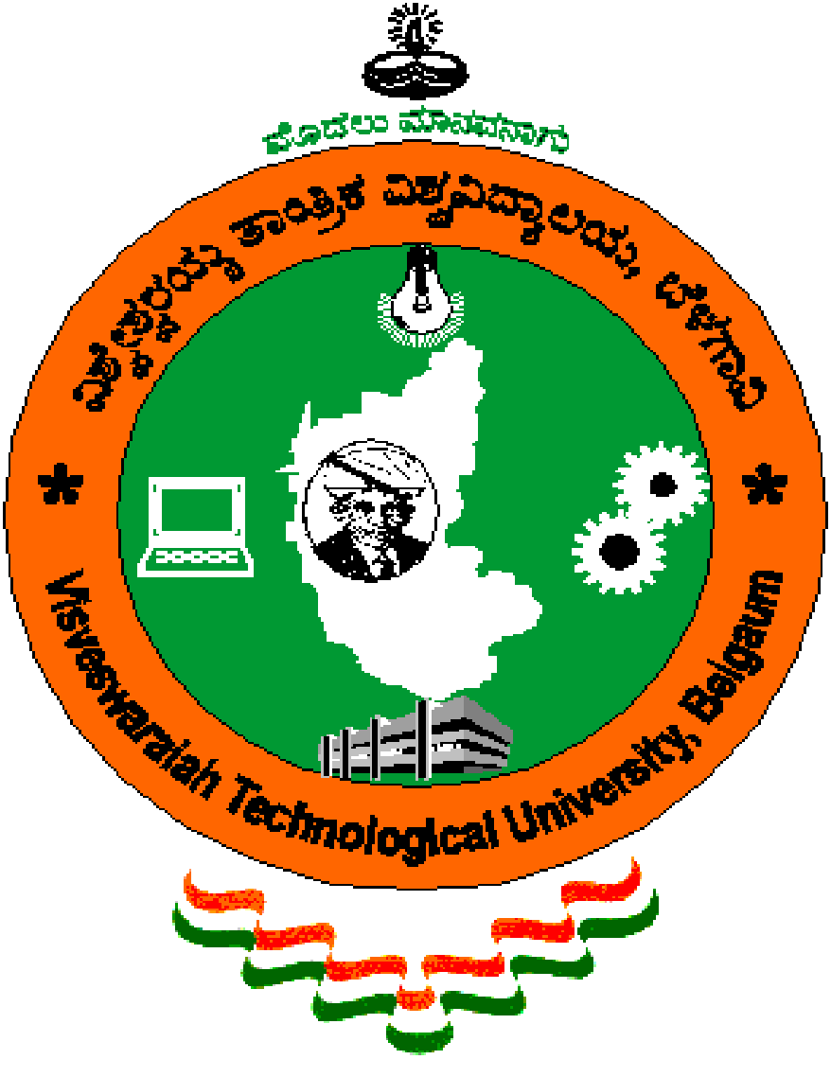
“Virtual Mouse using hand gestures and voice recognition”
Students:
Nitheesh Shetty(1RN19CS091)
Nitish K (1RN19CS092)
Rakshith BK (1RN19CS108)
Rajatha Bangera (1RN20CS411)
Guide:
Mrs. Yashasvi B N
Asst. Prof. Dept. of CSE, RNSIT
Department of Computer Science and Engineering
RNS Institute of Technology
2022-23

Slide 2
CONTENTS
INTRODUCTION
Back ground work
Problem Statement
Existing System and Limitations
Objectives
Proposed system
REQUIREMENTS
SYSTEM ARCHITECTURE/BLOCK DIAGRAM
INNOVATIVENESS & USEFULNESS
IMPLIMENTATIONS
CONCLUSION
REFERENCES

Slide 3
INTRODUCTION
Background work :
To develop and implement an alternative system to control a mouse cursor..
To develop a system which recognizes hand gesture and controls mouse cursor using color detection method of any computer..
Problem Statement:
To track fingertips as a movable object, and to utilize it for mouse functions. A virtual mouse instead of a physical mouse works based on webcam captured frames & tracking colored fingertips.
Existing System and Limitations:
The existing system consists of the generic mouse and trackpad system of monitor controlling and the non-availability of a hand gesture system. The remote accessing of monitor screen using the hand gesture is unavailable.
The system made used is the static hand recognition which is simply recognition of the shape made by hand and by defining an action for each shape made, which is limited to a number of defined actions and a large amount of confusion.

Slide 4
Objectives:
The objective is to develop and implement an alternative system to control a mouse cursor.
The alternative method is hand gesture recognition using webcam and color detection method.
The ultimate outcome is to develop a system which recognizes hand gesture and controls mouse
cursor using color detection method of any computer.
Proposed System:
Using the current system even-though there are a number of quick access methods available for the hand and mouse gesture for the laptops, using our project we could make use of the laptop or web-cam and by recognizing the hand gesture.
We could control mouse and perform basic operations like mouse pointer controlling, select and deselect using left click, and a quick access feature for file transfer.
We have mainly concentrated on the mouse pointing and clicking actions along with an action for the file transfer between folders by hand action and the movements. The system we are implementing which is been written in python code

Slide 5
REQUIREMENTS
Software Requirements:
Operating System: Windows 10
Language: Python
Integrated Development Environment: Google Collaboratory, Jupyter Notebook, PyCharm, Anaconda
Hardware Requirements:
Processor: 10TH Gen CORE i5 Processor
RAM: 8GB
Hard Disk: 512 GB SSD

Slide 6
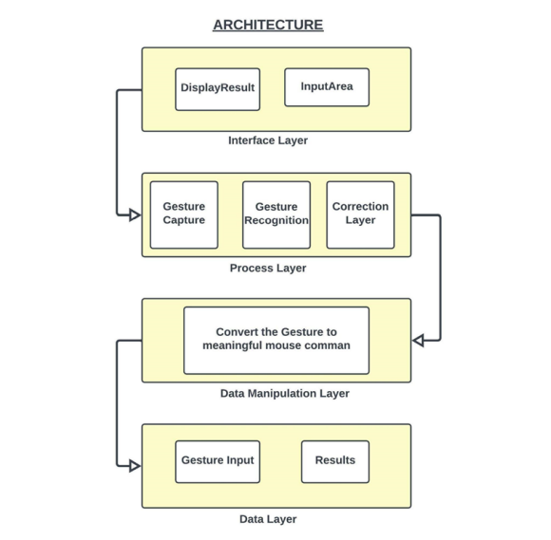
SYSTEM ARCHITECTURE

Slide 7
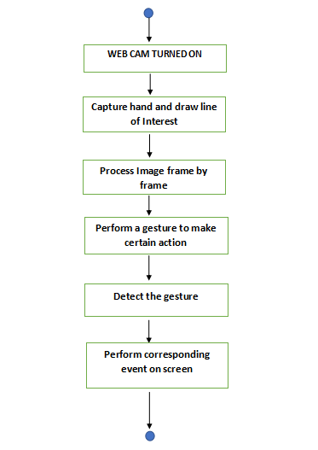
FLOW CHART

Slide 8
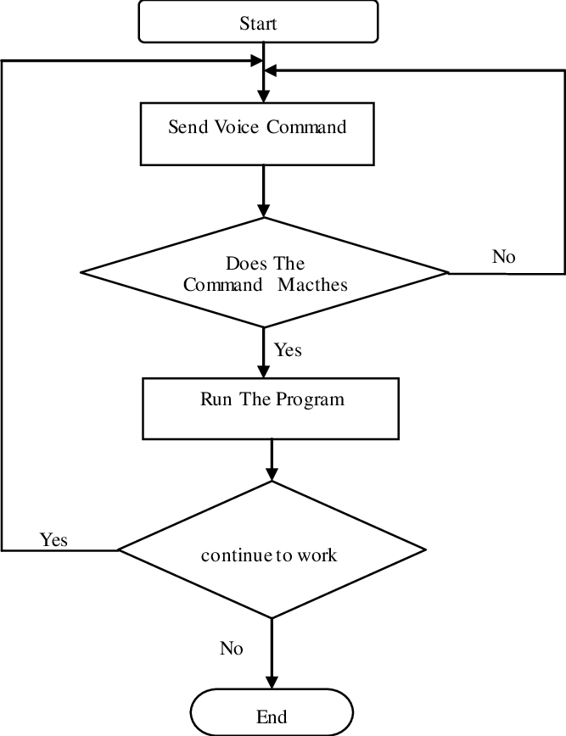
FLOW CHART

Slide 9
INNOVATIVENESS & USEFULNESS
INNOVATIVENESS:
Virtual Mouse that will soon to be introduced to replace the physical computer mouse
to promote convenience while still able to accurately interact and control the computer
system.
Therefore, this project will develop a software application with the aid of the latest software coding technique and the open-source computer vision library also known as the OpenCV.
USEFULNESS:
Gesture Controlled Virtual Mouse makes human computer interaction simple by making use of Hand Gestures and Voice Commands.
All i/o operations can be virtually controlled by using static and dynamic hand gestures along with a voice assistant.
Can be used for transferring between folders without the use of a physical mouse as well

Slide 10
TECHNOLOGIES USED
Computer Vision
Image classification
Object detection
Object Tracking
Content-based image retrieval
Hand Tracking / MediaPipes
Mediapipe is a framework mainly used for building audio, video, or any time series data.
With the help of the MediaPipe framework, we can build very impressive pipelines for
different media processing functions.
Installing Libraries for voice recognition and assistance
SpeechRecognition
PyAudio
pyttsx3
pywhatkit
wikipedia

Slide 11
IMPLIMENTATION
Camera:
The system works on the frames captured by the webcam on the computer machine or built-in camera on a laptop. By creating the video capture object, the system will capture video using webcam in real-time. The camera will capture frame by frame and will pass it to the system. Camera resolution is 1920*1080 and with fps of 40
Capturing:
While the device is ON and when the model is run. The model will open a tab of the camera which takes input from the user. By using an infinite loop the webcam captures each and every frame till the program termination. The frames from the real-time video are processed from BGR to HSV color space.

Slide 12
Color Detection & Masking:
In this proposed system, color detection is done by detecting color pixels of fingertips with color caps from the frames that were captured by the webcam. This is the initial and fundamental step of the proposed system.
The outcome of this step will be a grayscale image, where the intensity of the pixels differs the color cap from the rest of the frame and the color cap area will be highlighted. Then rectangle masks will be created around the color cap and the color cap will be tracked. The gesture will be detected from the tracking of these color caps.

Slide 13
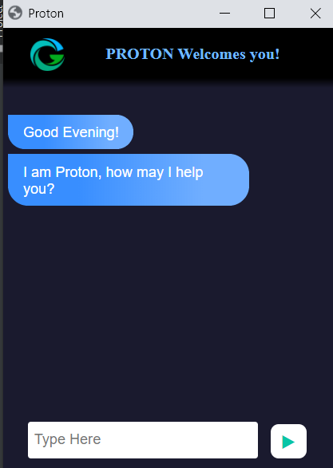
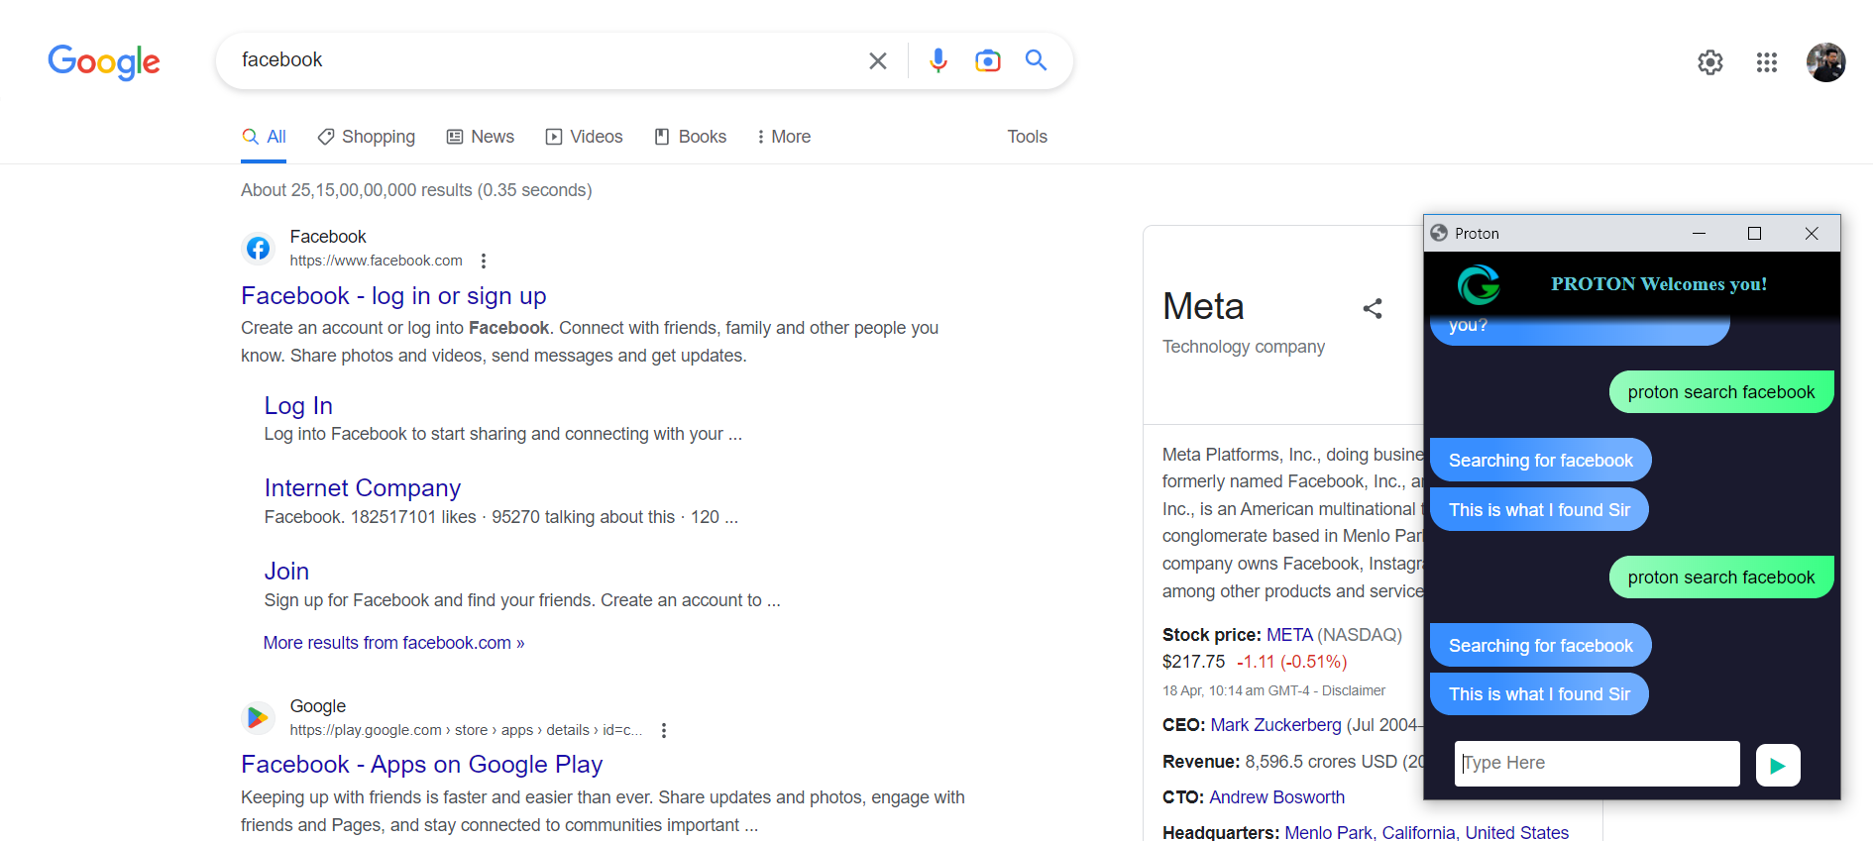
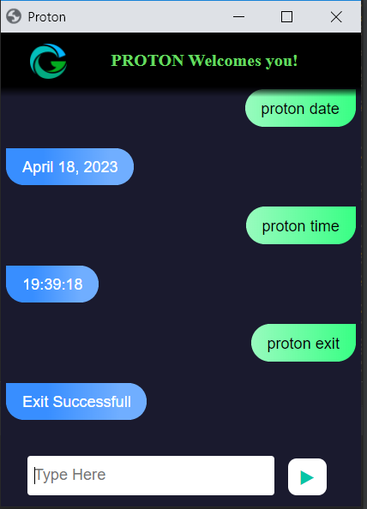
Result Analysis
Starting Proton
Performing Search operation
Date and Time Operation

Slide 14
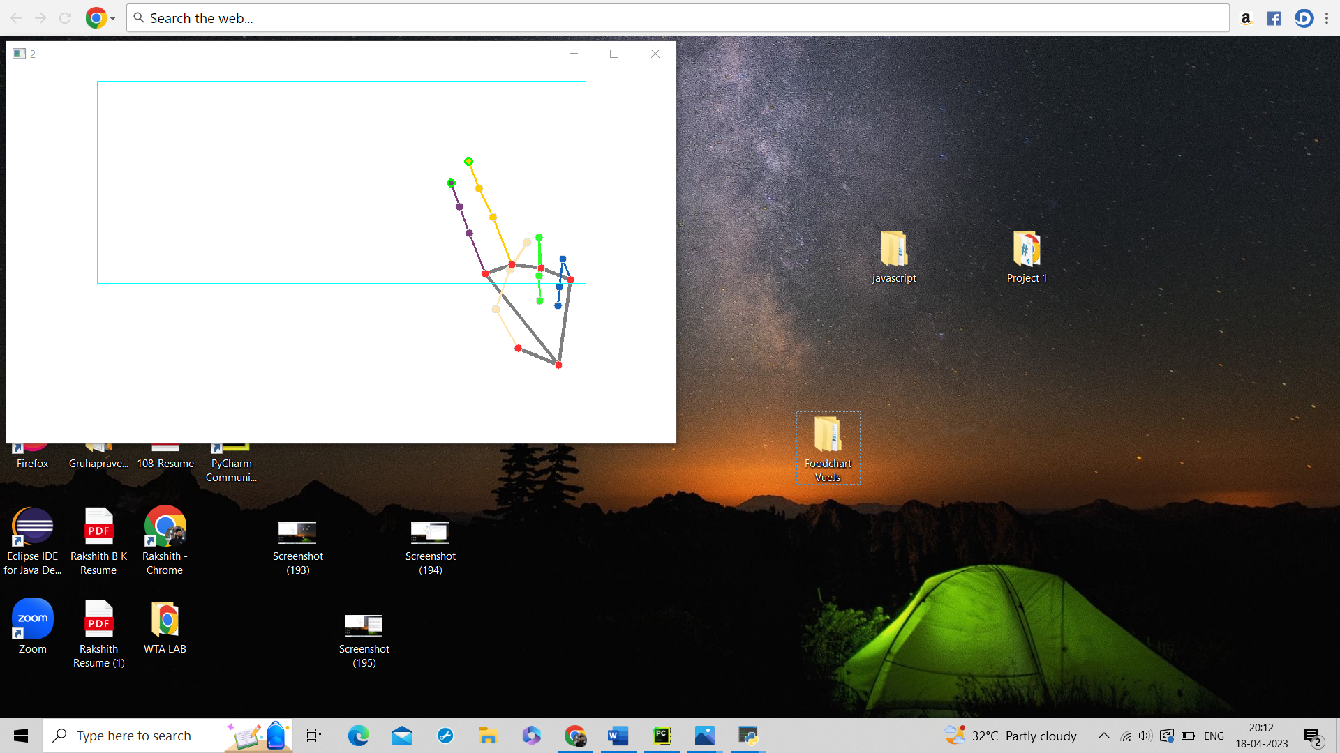
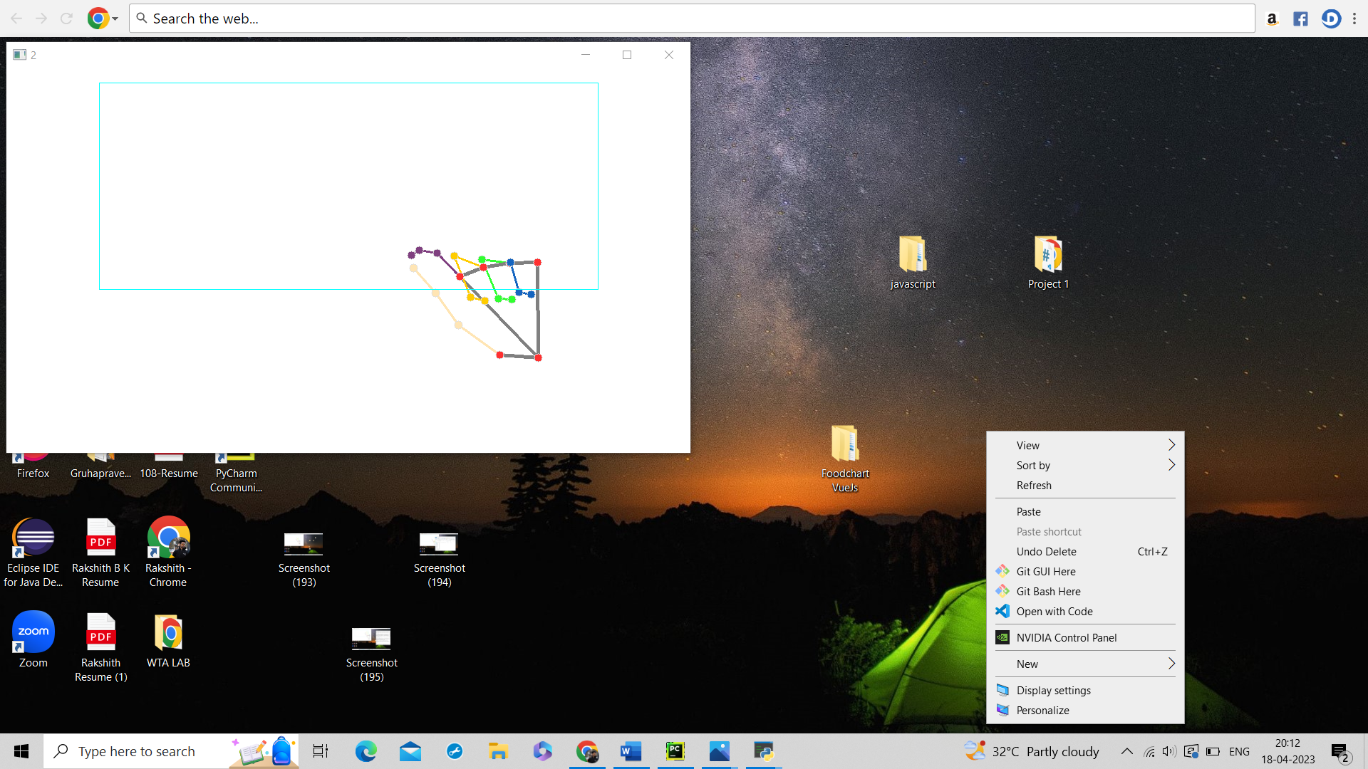
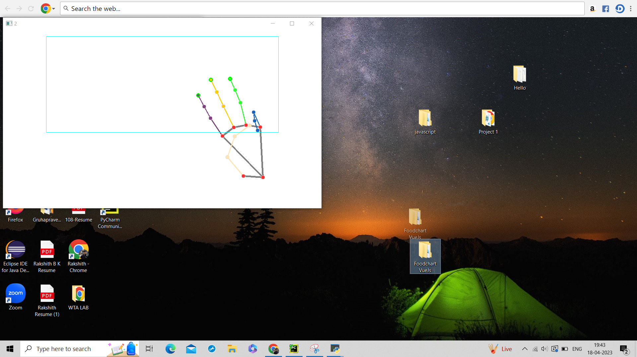
Result Analysis
Left Click
Right Click
Drag and Drop

Slide 15
CONCLUSION
Existing system limitations:
The system made used is the static hand recognition which is simply recognition of the shape made by hand and by defining an action for each shape made, which is limited to a number of defined actions and a large amount of confusion.
Proposed system Advantages:
Gesture recognition gives the best interaction between human and machine.
Gesture recognition is also important for developing alternative human computer interaction modalities.
Gesture recognition can be used for many applications like sign language recognition for deaf and
dumb people, robot control etc.
This technology has wide applications in the fields of augmented reality, computer graphics, computer gaming, prosthetics, and biomedical instrumentation.
Current Status of Development:
Completed research work and technologies to be used
Completed analysis of the requirements required to build an efficient Virtual Mouse/Cursor.

Slide 16
REFERENCES
[1]Deep Learning By Example by Md. Rezaul Karim, Ahmed Menshawy
[2]https://medium.com/mlearning-ai/character-based-neural-language-modelling-using-lstm-bfb136bebb3b[1]https://www.researchgate.net/publication/345728460_The_prediction_of_character_based_on_recurrent_neural_network_language_model
[3]https://www.analyticsvidhya.com/blog/2021/03/introduction-to-long-short-term-memory-lstm
[4]https://www.researchgate.net/publication/345728460_The_prediction_of_character_based_on_recurrent_neural_network_language_model

Slide 17
DEMO

Slide 18
THANK YOU!!!

